Slide 1
Background
Increasing use of automated systems
Hardware and software technology are improving rapidly
User interface technology is lagging
Critical bottleneck is now user interface, not processing
Two powerful information processors communicating via narrow-bandwidth, highly constrained interface
Goal: Increase bandwidth across channel
Start from human's perceptual abilities, processes, organs
Then work toward devices, interaction techniques, not reverse

Slide 2
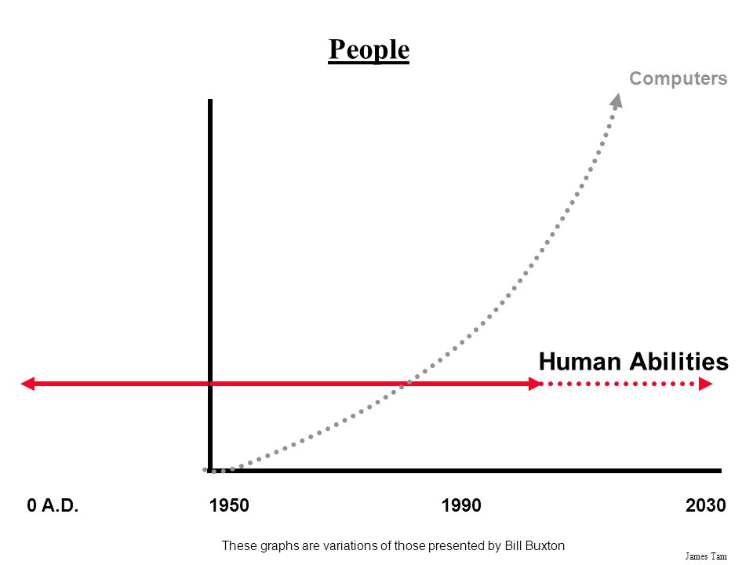
Human Abilities vs. Computer Abilities

Slide 3
Computer Science and HCI
Problems and opportunities in this area increasing, not decreasing, with new technology
Easier to use
Harder to program
Simple engineering methods for good interfaces do not exist yet
Still need iterative development, prototyping, and testing
Hence user interface code is most changeable part of a system
Some major concepts
Basic interaction styles
Dialogue independence
Levels: conceptual, semantic, syntactic, lexical
User interface software: UIMS, UIDL
New interaction styles (non-WIMP)

Slide 4
What is a human-conputer interface?
Definition of all inputs from user to computer
Definition of all outputs from computer to user
Definition of sequencing of inputs and outputs
What the user sees/perceives
Not how it is implemented

Slide 5
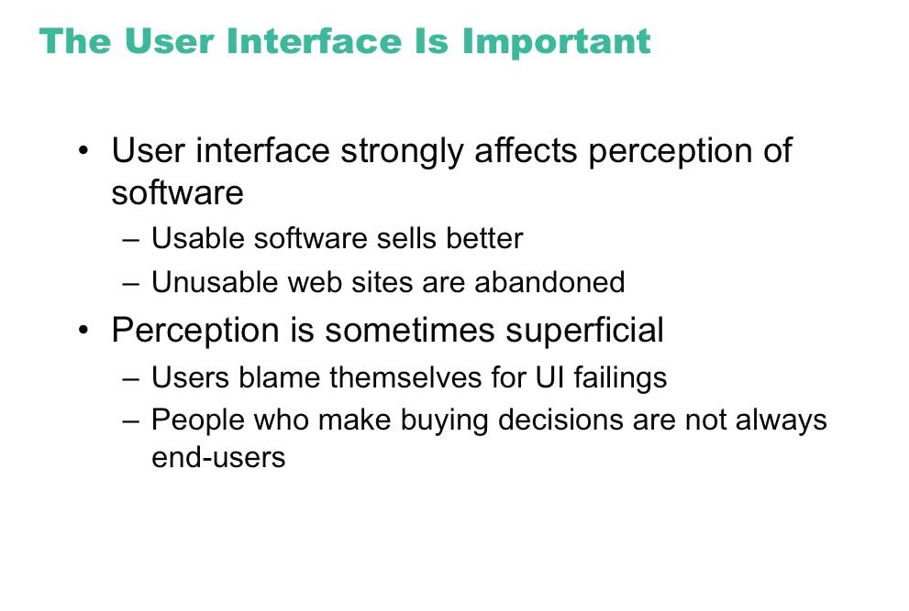

Slide 6
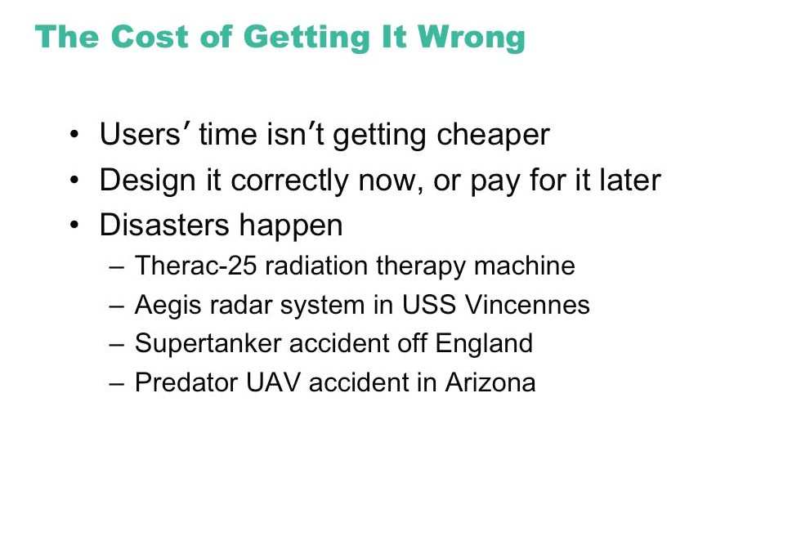

Slide 7
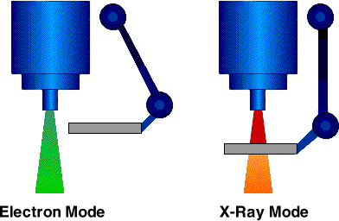
The Therac-25 Accidents
Poor Design Induces Error, Even for Highly-trained Operators
Fatal radiation overdoses delivered by a software-controlled, medical linear accelerator for cancer treatment
Accidents were attributed to a combination of software errors and poorly-design user interface
The operators were mislead about the true status of machine configuration (electron beam intensity and tungsten target)
Six patients received 25,000 rads and two died in 1985-87

Slide 8
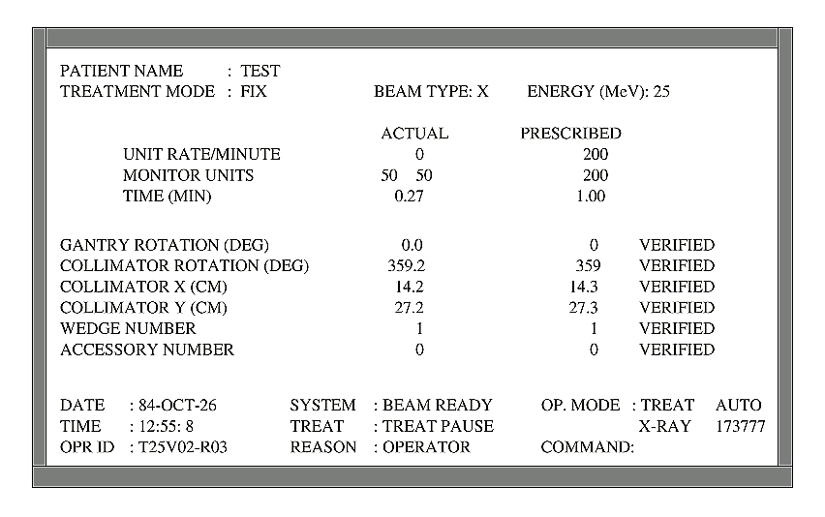
Therac-25 user interface
(with permission, from Leveson, N. Safeware: System Safety and Computers. Addison-Wesley, 1995)

Slide 9
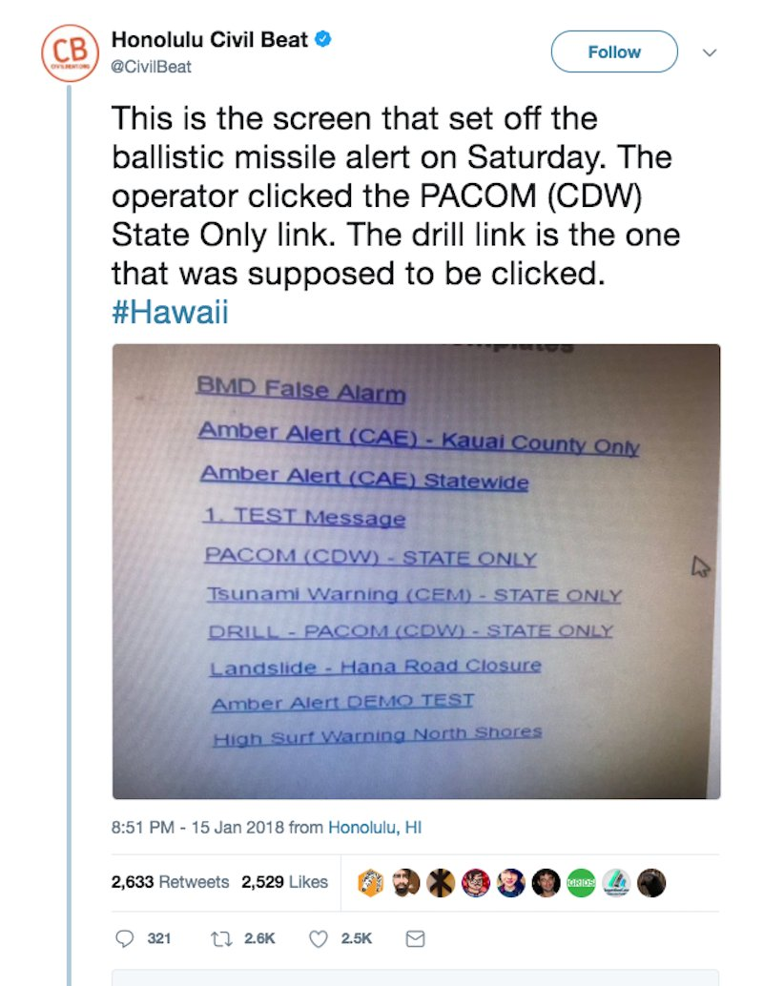
2018 Hawaii Ballistic Missile False Alert
Notes:
I believe this is a mockup, not the actual screen, made by someone familiar with the actual screen. But the actual one is classified.

Slide 10
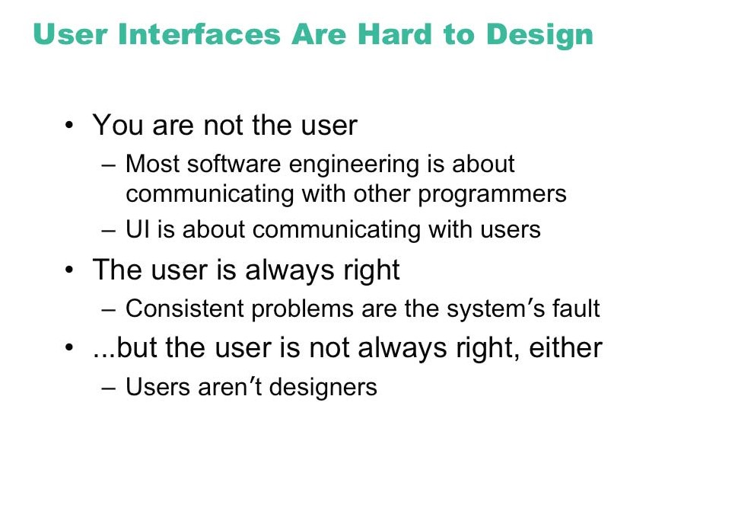

Slide 11
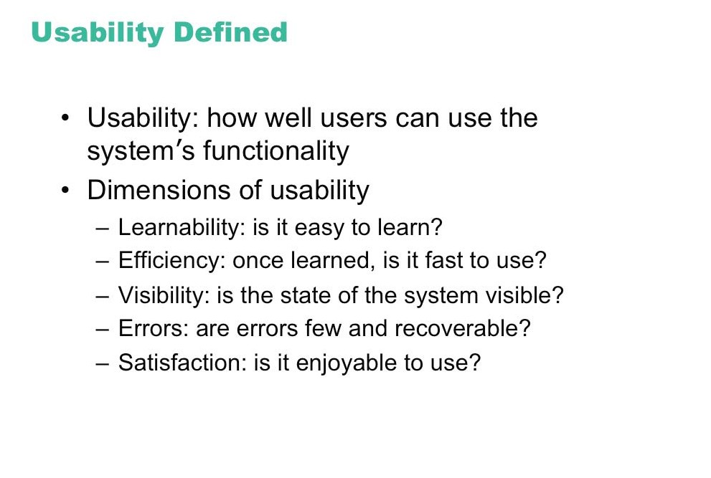

Slide 12
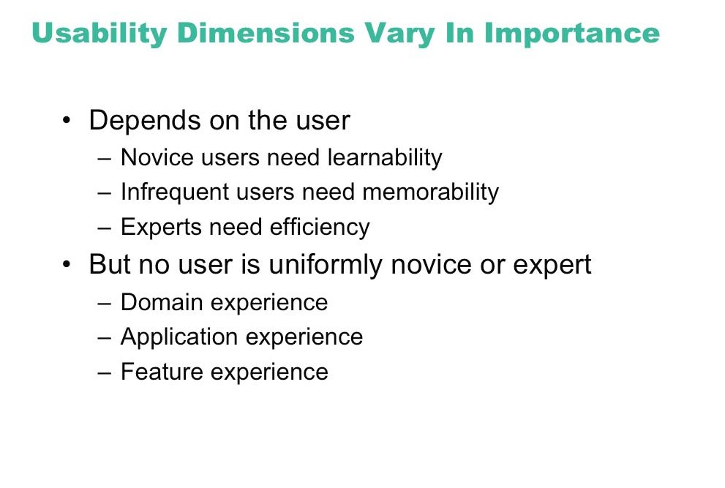

Slide 13
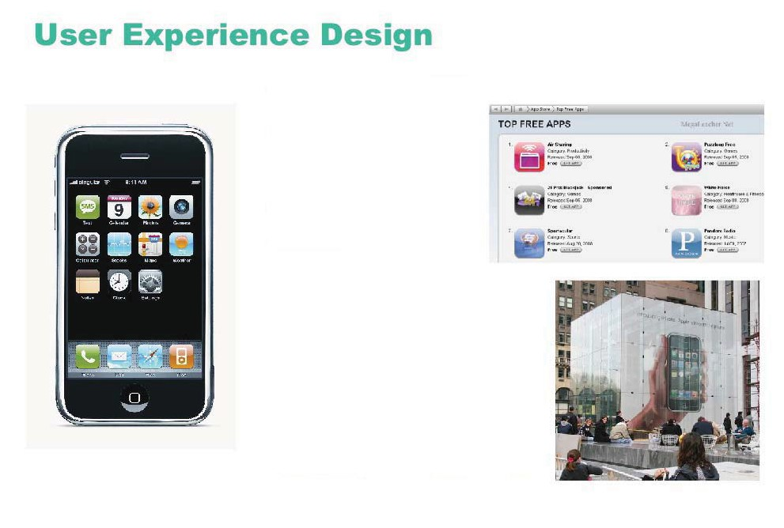
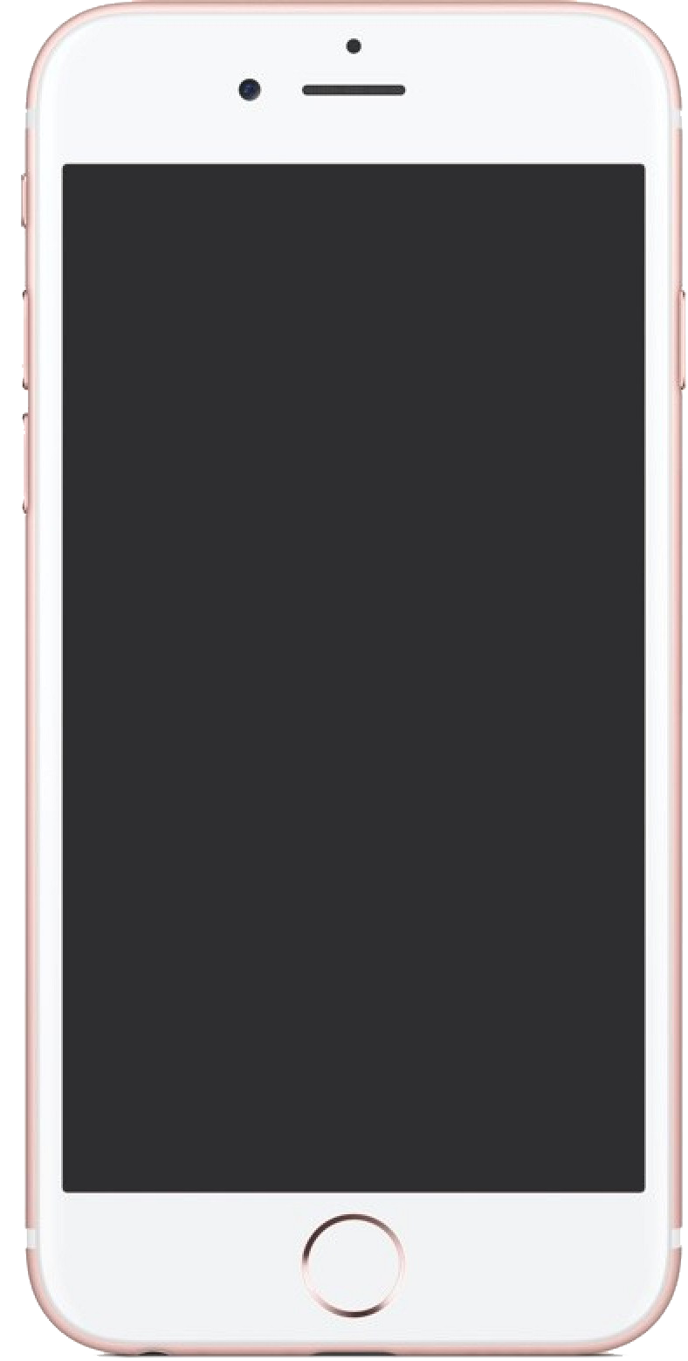
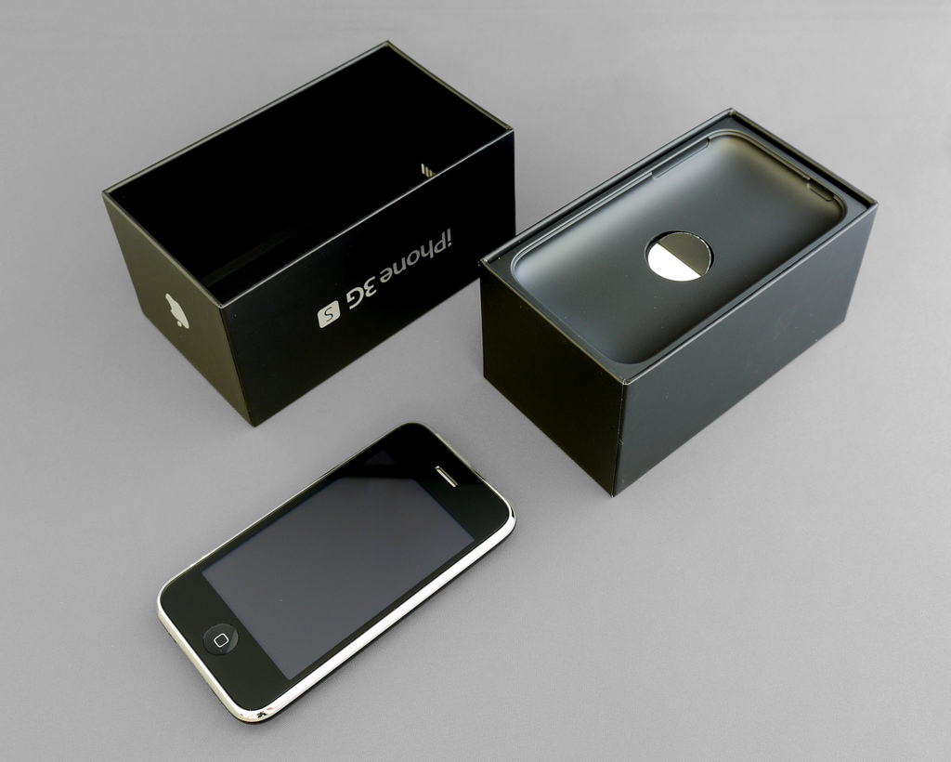
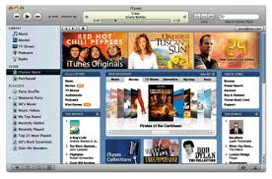
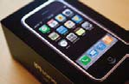
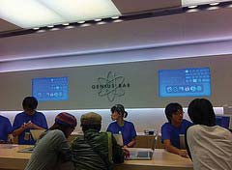
Image courtesy of YU-TA LEE on Flickr.

Slide 14
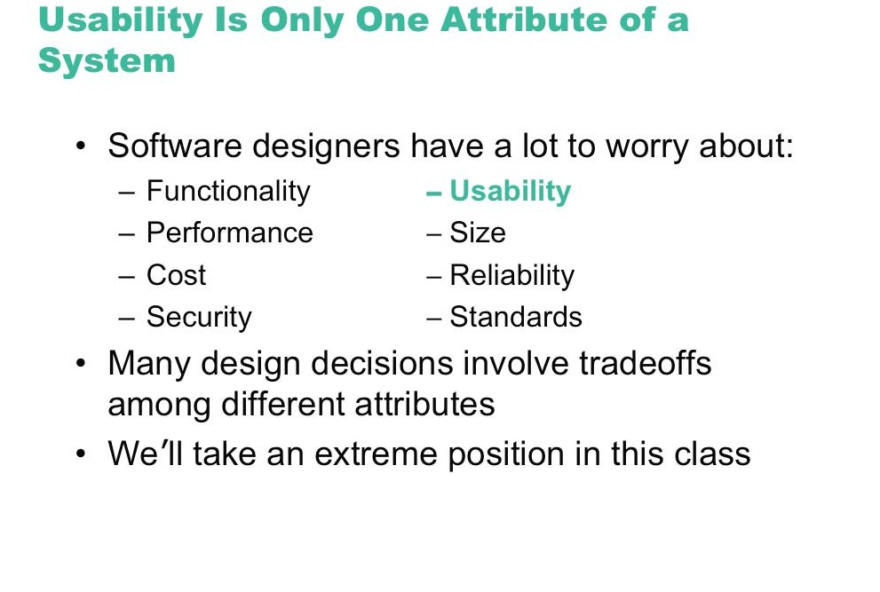

Slide 15
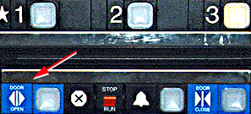
Bad designs
Elevator controls and labels on the bottom row all look the same, so it is easy to push a label by mistake instead of a control button
People do not make same mistake for the labels and buttons on the top row. Why not?
From: www.baddesigns.com

Slide 16
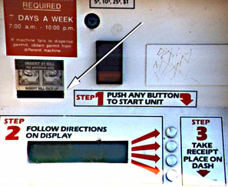
Why is this vending machine so bad?
Need to push button first to activate reader
Normally insert bill first before making selection
Contravenes well known convention
From: www.baddesigns.com

Slide 17
Good design
Marble answering machine (Bishop, 1995)
Based on how everyday objects behave
Easy, intuitive and a pleasure to use
Only requires one-step actions to perform core tasks

Slide 18
Good and bad design
What is wrong with the Apex remote?
Why is the TiVo remote so much better designed?
Peanut shaped to fit in hand
Logical layout and color-coded, distinctive buttons
Easy to locate buttons

Slide 19
What to design
Need to take into account:
Who the users are
What activities are being carried out
Where the interaction is taking place
Need to optimize the interactions users have with a product
So that they match the users’ activities and needs

Slide 20
Understanding users’ needs
Need to take into account what people are good and bad at
Consider what might help people in the way they currently do things
Think through what might provide quality user experiences
Listen to what people want and get them involved
Use tried and tested user-centered methods

Slide 21
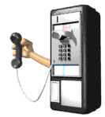
Activity
How does making a call differ when using a:
Cell phone
Public phone box?
Consider the kinds of user, type of activity and context of use

Slide 22
What is interaction design?
Designing interactive products to support the way people communicate and interact in their everyday and working lives
Sharp, Rogers and Preece (2007)
The design of spaces for human communication and interaction
Winograd (1997)

Slide 23
Goals of interaction design
Develop usable products
Usability means easy to learn, effective to use and provide an enjoyable experience
Involve users in the design process

Slide 24
Which kind of design?
Number of other terms used emphasizing what is being designed, e.g.,
user interface design, software design, user-centered design, product design, web design, experience design (UX)
Interaction design is the umbrella term covering all of these aspects
fundamental to all disciplines, fields, and approaches concerned with researching and designing computer-based systems for people

Slide 25
The User Experience
How a product behaves and is used by people in the real world
the way people feel about it and their pleasure and satisfaction when using it, looking at it, holding it, and opening or closing it
“every product that is used by someone has a user experience: newspapers, ketchup bottles, reclining armchairs, cardigan sweaters.” (Garrett, 2003)
Cannot design a user experience, only design for a user experience

Slide 26
Why was the iPod user experience such a success?

Slide 27
What is involved in the process of interaction design
Identifying needs and establishing requirements for the user experience
Developing alternative designs to meet these
Building interactive prototypes that can be communicated and assessed
Evaluating what is being built throughout the process and the user experience it offers

Slide 28
Core characteristics of interaction design
Users should be involved through the development of the project
Specific usability and user experience goals need to be identified, clearly documented and agreed at the beginning of the project
Iteration is needed through the core activities

Slide 29
Anna, IKEA online sales agent
Designed to be different for UK and US customers
What are the differences and which is which?
What should Anna’s appearance be like for other countries, like India, South Africa, or China?

Slide 30
Usability goals
Effective to use
Efficient to use
Safe to use
Have good utility
Easy to learn
Easy to remember how to use

Slide 31
Activity on usability
How long should it take and how long does it actually take to:
Using a DVD to play a movie?
Use a DVD to pre-record two programs?
Using a web browser tool to create a website?

Slide 32
Design principles
Generalizable abstractions for thinking about different aspects of design
The do’s and don’ts of interaction design
What to provide and what not to provide at the interface
Derived from a mix of theory-based knowledge, experience and common-sense

Slide 33
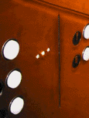
Visibility
• This is a control panel for an elevator
• How does it work?
• Push a button for the floor you want?
• Nothing happens. Push any other button? Still nothing. What do you need to do?
It is not visible as to what to do!
From: www.baddesigns.com

Slide 34
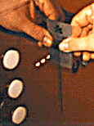
Visibility
…you need to insert your room card in the slot by the buttons to get the elevator to work!
How would you make this action more visible?
• make the card reader more obvious
• provide an auditory message, that says what to do (which language?)
• provide a big label next to the card reader that flashes when someone enters
• make relevant parts visible
• make what has to be done obvious

Slide 35
Feedback
Sending information back to the user about what has been done
Includes sound, highlighting, animation and combinations of these
e.g. when screen button clicked on provides sound or red highlight feedback:
“ccclichhk”

Slide 36
Constraints
Restricting the possible actions that can be performed
Helps prevent user from selecting incorrect options
Physical objects can be designed to constrain things
e.g. only one way you can insert a key into a lock

Slide 37
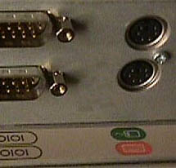
Logical or ambiguous design?
Where do you plug the mouse?
Where do you plug the keyboard?
top or bottom connector?
Do the color coded icons help?
From: www.baddesigns.com

Slide 38
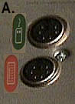
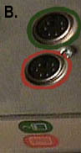
How to design them more logically
(i) A provides direct adjacent mapping between icon and connector
(ii) B provides color coding to associate the connectors with the labels
From: www.baddesigns.com

Slide 39
Consistency
Design interfaces to have similar operations and use similar elements for similar tasks
For example:
always use ctrl key plus first initial of the command for an operation – ctrl+C, ctrl+S, ctrl+O
Main benefit is consistent interfaces are easier to learn and use

Slide 40
When consistency breaks down
What happens if there is more than one command starting with the same letter?
e.g. save, spelling, select, style
Have to find other initials or combinations of keys, thereby breaking the consistency rule
e.g. ctrl+S, ctrl+Sp, ctrl+shift+L
Increases learning burden on user, making them more prone to errors

Slide 41
Internal and external consistency
Internal consistency refers to designing operations to behave the same within an application
Difficult to achieve with complex interfaces
External consistency refers to designing operations, interfaces, etc., to be the same across applications and devices
Very rarely the case, based on different designer’s preference

Slide 42
Keypad numbers layout
A case of external inconsistency
(a) phones, remote controls
(b) calculators, computer keypads
1
2
3
7
8
9
4
5
6
4
5
6
7
8
9
1
2
3
0
0

Slide 43
Affordances: to give a clue
Refers to an attribute of an object that allows people to know how to use it
e.g. a mouse button invites pushing, a door handle affords pulling
Norman (1988) used the term to discuss the design of everyday objects
Since has been much popularised in interaction design to discuss how to design interface objects
e.g. scrollbars to afford moving up and down, icons to afford clicking on

Slide 44
What does ‘affordance’ have to offer interaction design?
Interfaces are virtual and do not have affordances like physical objects
Norman argues it does not make sense to talk about interfaces in terms of ‘real’ affordances
Instead interfaces are better conceptualized as ‘perceived’ affordances
Learned conventions of arbitrary mappings between action and effect at the interface
Some mappings are better than others

Slide 45

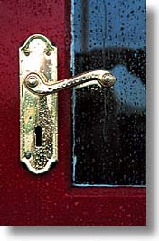
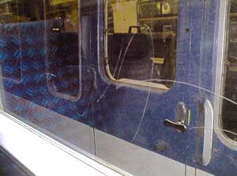
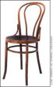
Activity
Physical affordances:
How do the following physical objects afford? Are they obvious?

Slide 46
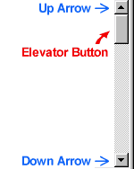


Activity
Virtual affordances
How do the following screen objects afford?
What if you were a novice user?
Would you know what to do with them?

Slide 47
Takeaways
You and I are not representative users
Base design on knowledge about real users, not on introspection
What you see is the last part of what you get
The most important aspects of user interface design are least visible: task structure, conceptual models, information flows
User interfaces, as software products, must be engineered
Make engineering tradeoffs
Design is an art
Not a strictly top-down process
There is scientific knowledge to be applied to user interface design and development
Cognitive science, social science, techniques from computer science

Slide 48
Acknowledgments
Many of the slides for this and other lectures are adapted from:
Prof. Robert Miller, MIT
Prof. Saul Greenberg, University of Calgary

